Slide 1

Notes:
# AI for Teams - Smart Adoption Not Blind FOMO

Slide 2
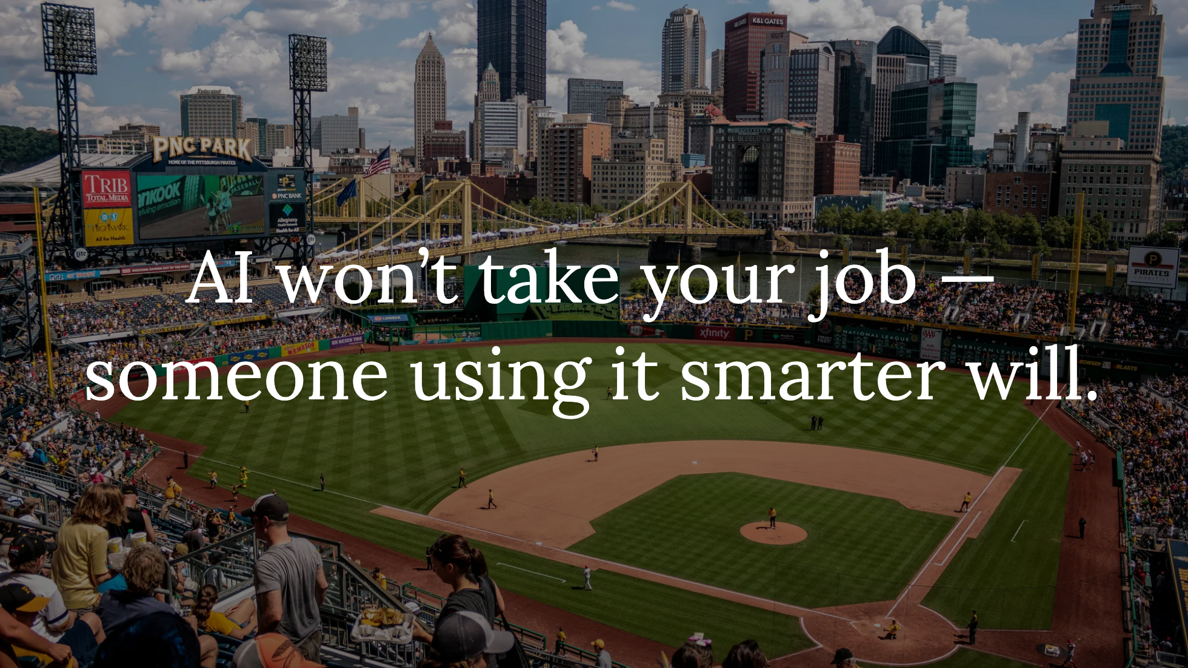
Notes:
- Hook: “AI won’t take your job — someone using it smarter will.” - Quick audience check: - Who has experimented with AI? - Who feels overwhelmed by the AI hype? - Who is dealing with "AI FOMO" i.e. "We need to do AI now!"? - The AI landscape: Why everyone is talking about it and why FOMO isn’t a strategy.

Slide 3

Notes:
- What AI **is** and **isn’t** (brief overview of LLMs, generative AI, automation) - Common myths: - “AI will do everything for you.” - “AI is a silver bullet that makes work faster and easier.” - “AI will replace software engineers.” - “If we don’t adopt AI now, we’ll fall behind.” - Reality check: AI **augments**, not replaces—unless you don’t learn how to use it.

Slide 4
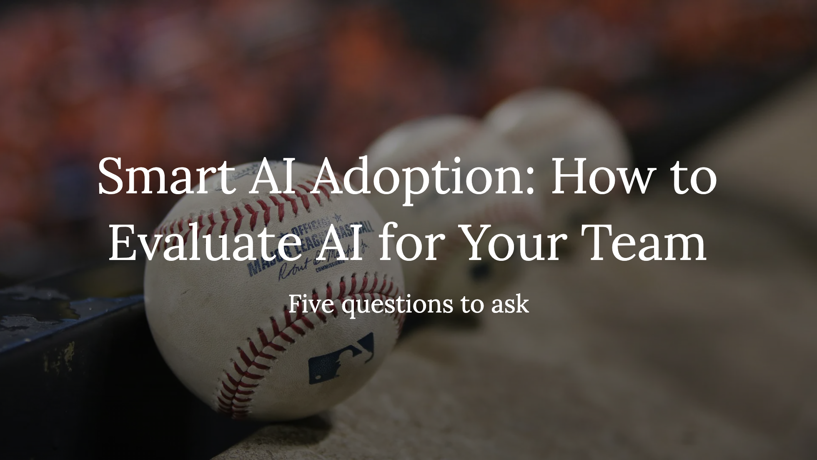
Notes:
1. Does this AI tool solve a real problem, or is it just “cool”? 2. How does it impact efficiency vs. quality? 3. What are the risks (bias, security, ethics)? 4. Can we trust the outputs? 5. How does it fit into our existing workflows?

Slide 5
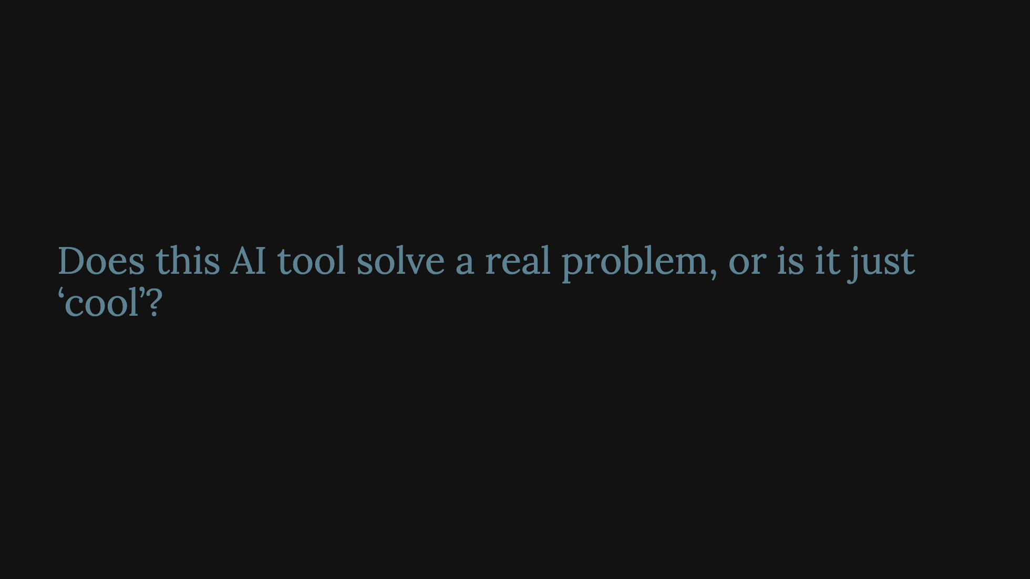
Notes:
- **Key Considerations:** - Clearly identify the problem or opportunity the AI is meant to address. - Determine measurable success criteria (e.g., reduced customer wait times, improved detection rates). - Collaborate with internal stakeholders to confirm the value and relevance of the identified problem.

Slide 6
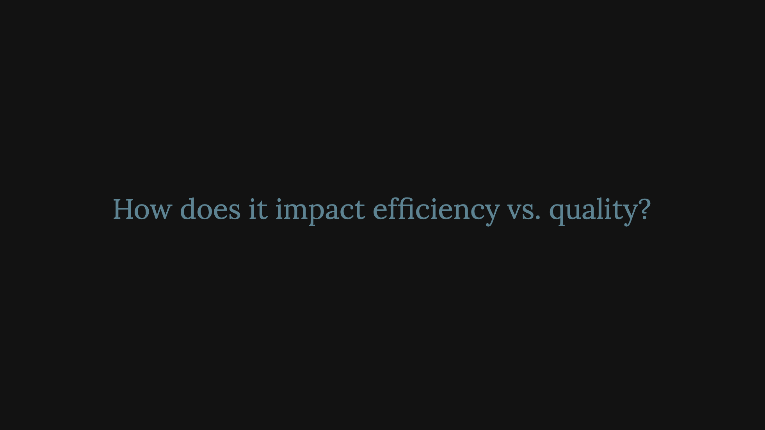
Notes:
- **Key Considerations:** - Understand whether the AI accelerates workflows (e.g., automated data entry) or if it can genuinely enhance quality (e.g., better predictions or improved insights). - Evaluate the trade-offs: speeding up a process could cause quality issues if the AI isn’t properly calibrated.

Slide 7
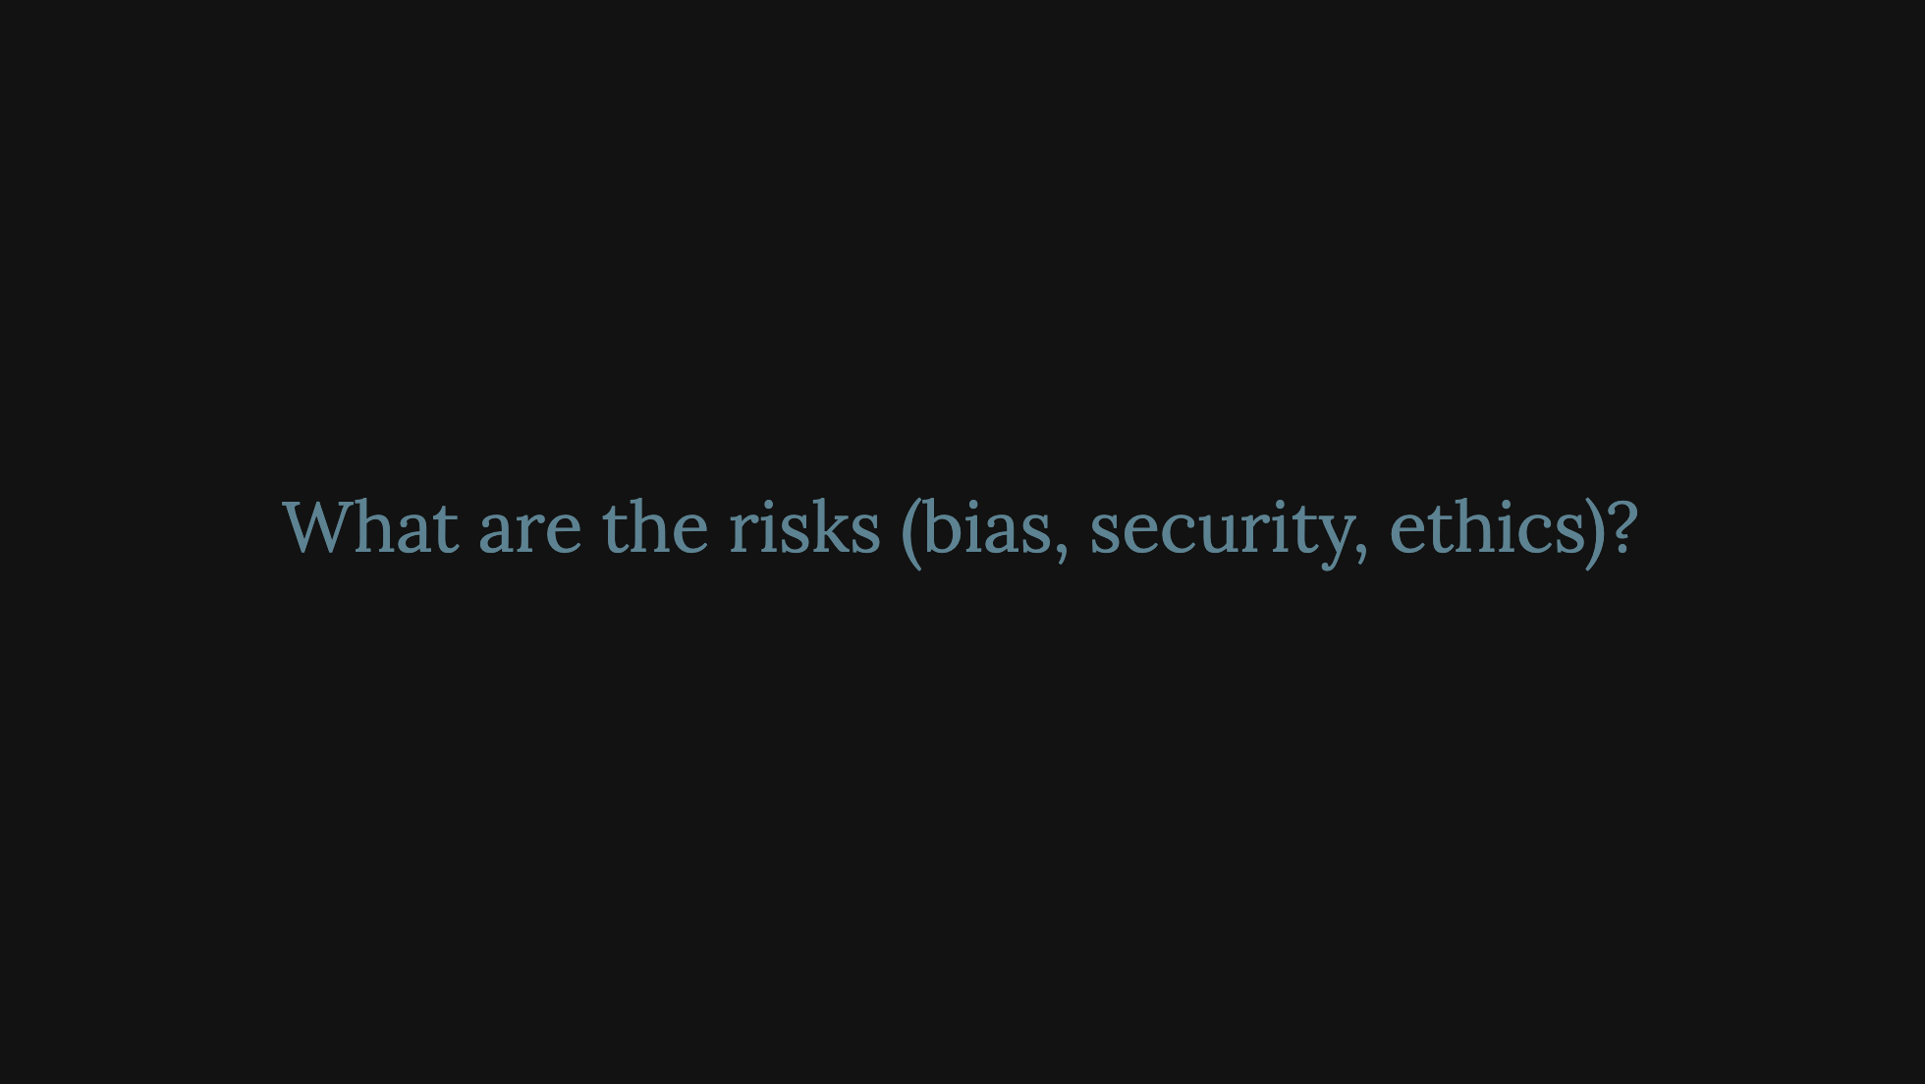
Notes:
- **Key Considerations:** - Assess known data biases or algorithmic blind spots that might lead to unfair outcomes. - Ensure the tool meets privacy and security standards, especially when handling sensitive information. - Evaluate the ethical implications: Does the AI’s operation comply with legal standards and organizational values?

Slide 8
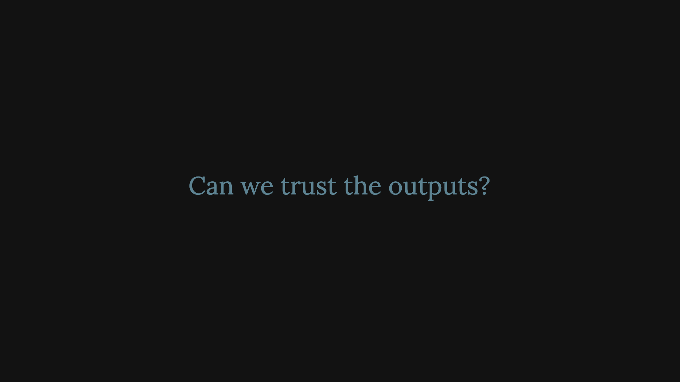
Notes:
- **Key Considerations:** - Validate accuracy through testing, pilot programs, or external audits. - Look into the AI’s “explainability” features: can the system provide insight into how it arrived at certain decisions? - Implement ongoing performance monitoring and include human oversight in critical decision points.

Slide 9
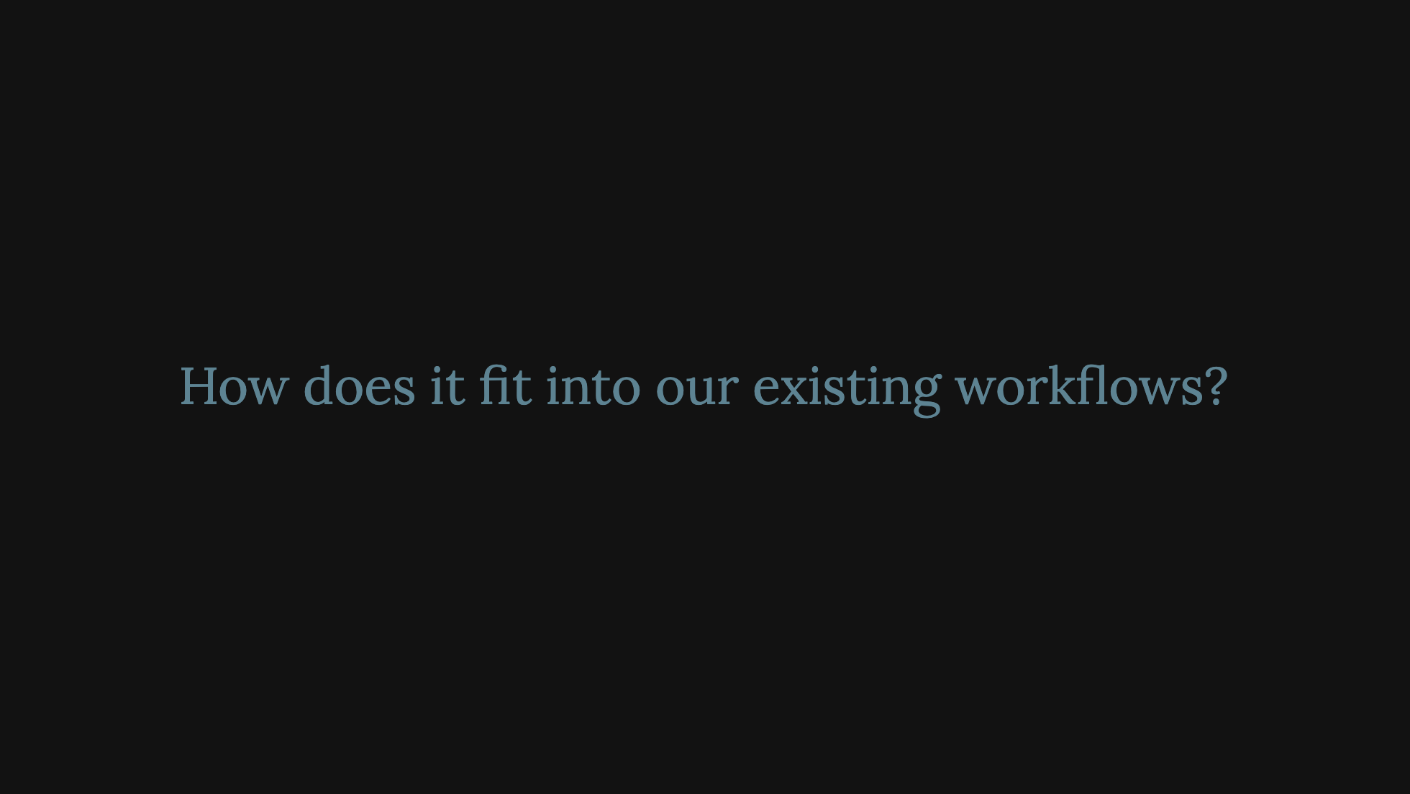
Notes:
- **Key Considerations:** - Determine if current systems need to be modified or replaced to support the AI tool. - Engage with frontline users early to identify potential frictions or training needs. - Plan for ongoing technical support and updates.

Slide 10


Slide 11
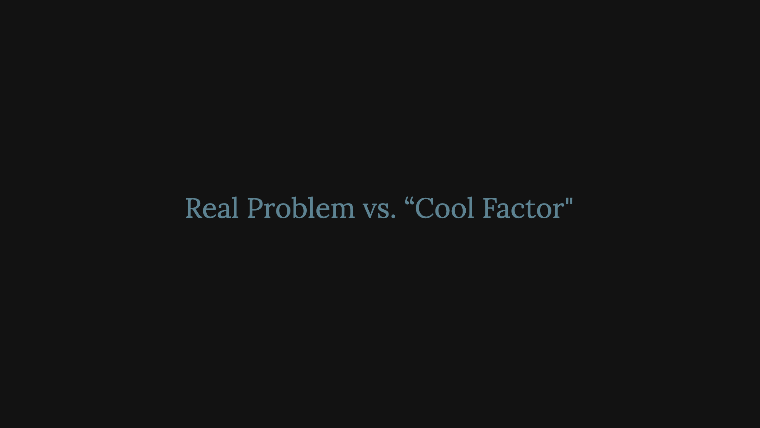
Notes:
1. **Vague Use Cases:** No one can articulate a clear, tangible problem the AI will solve. 2. **Hype-Driven Adoption:** The primary motive is “everyone else is doing it,” rather than solving a real need. 3. **No Clear KPIs:** Teams lack measurable indicators for success (e.g., efficiency gains, error reduction).

Slide 12
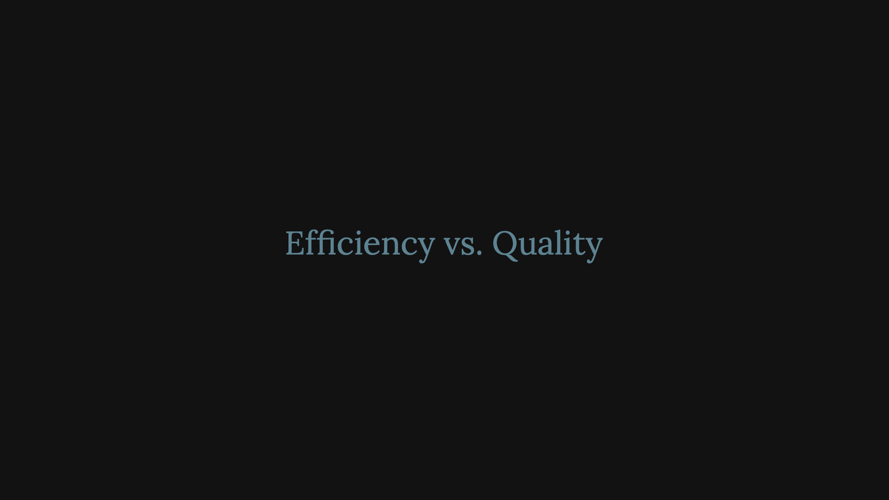
Notes:
> 1. **Overemphasis on Speed Alone:** All focus is on faster processes, with little consideration for accuracy or effectiveness. 2. **Hidden Quality Costs:** Small lapses in quality go unnoticed during early testing and can escalate after deployment.

Slide 13
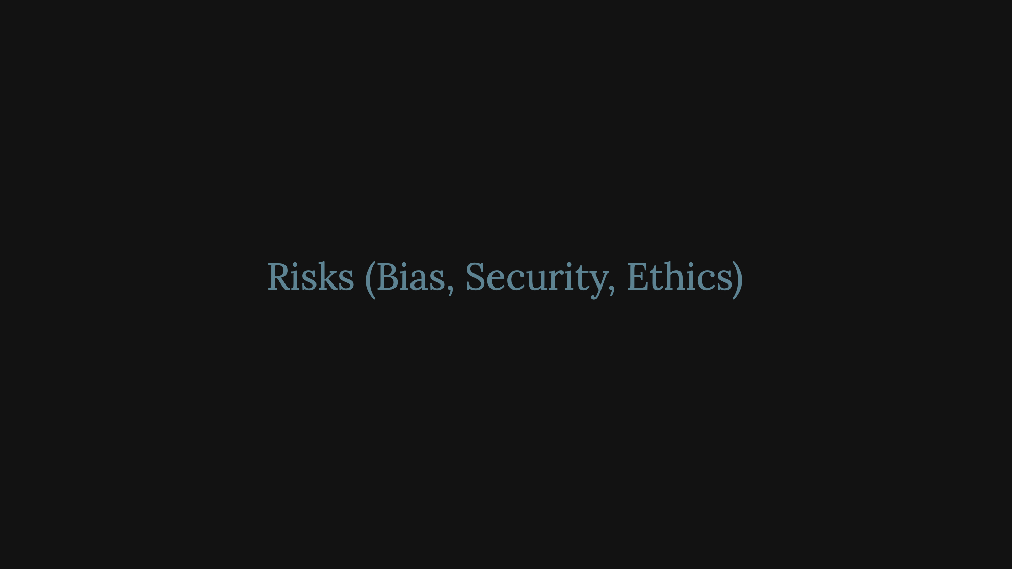
Notes:
1. **Unverified Data Sources:** Training data origins are unclear, raising concerns about accuracy or bias. 2. **Weak Security Protocols:** No transparent plan for preventing data breaches or securing sensitive information. 3. **No Ethical Guidelines:** No framework to address potential algorithmic discrimination or misuse of the tool.

Slide 14
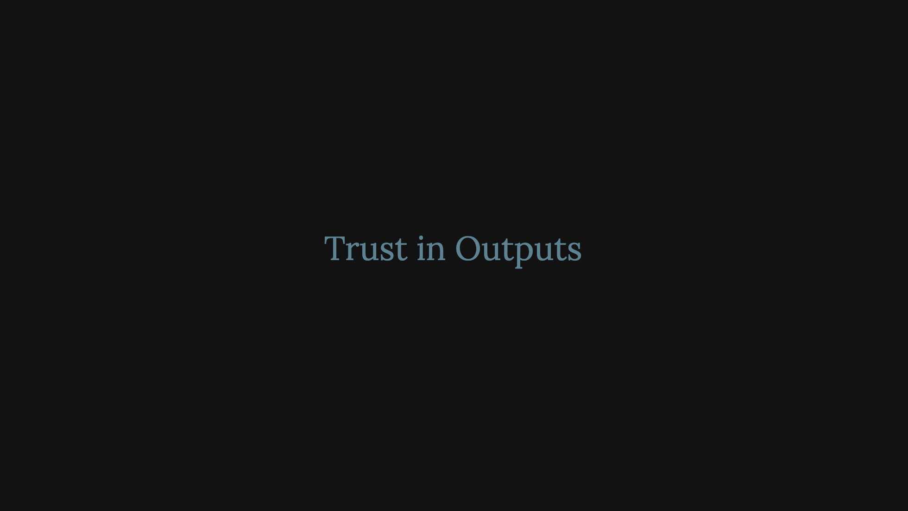
Notes:
1. **Black-Box Models with No Explanation:** The AI’s decision-making process is opaque, making it hard to diagnose errors or biases. 2. **No Mechanism for Verification:** There’s no systematic way to check or replicate results for accuracy. 3. **Limited Testing:** The tool is rolled out broadly with minimal piloting or staged deployment.

Slide 15

Notes:
1. **Major Workflow Disruption:** Implementation requires an overhaul of current systems, risking low user adoption and productivity dips. 1. **Inadequate User Training:** End users or frontline teams are not sufficiently prepared to integrate AI into their daily tasks. 1. **Lack of IT/Operations Readiness:** No clear plan for data management, software compatibility, or ongoing maintenance and support.

Slide 16
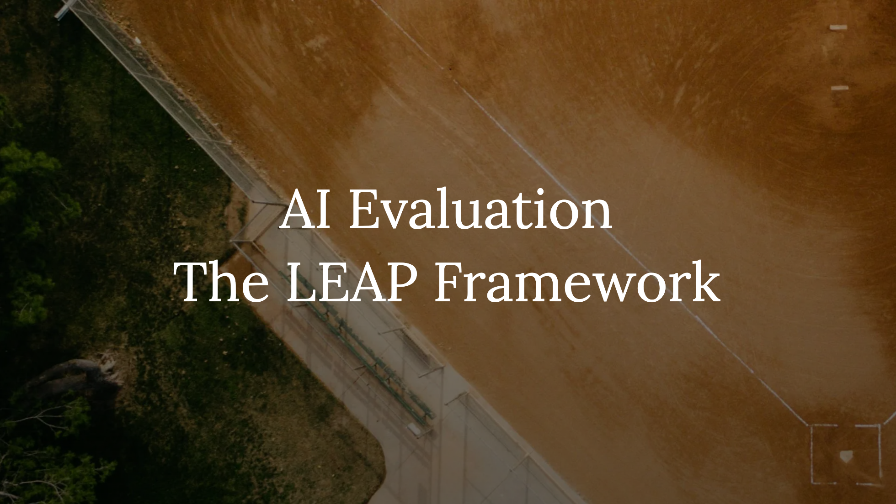
Notes:
- Distilling the Rubric - Learn, Evaluate, Apply, Practice

Slide 17
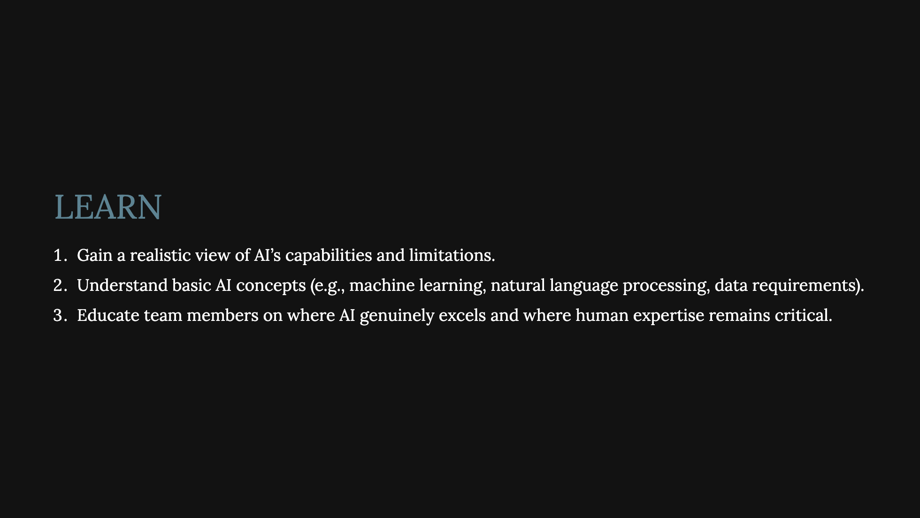

Slide 18
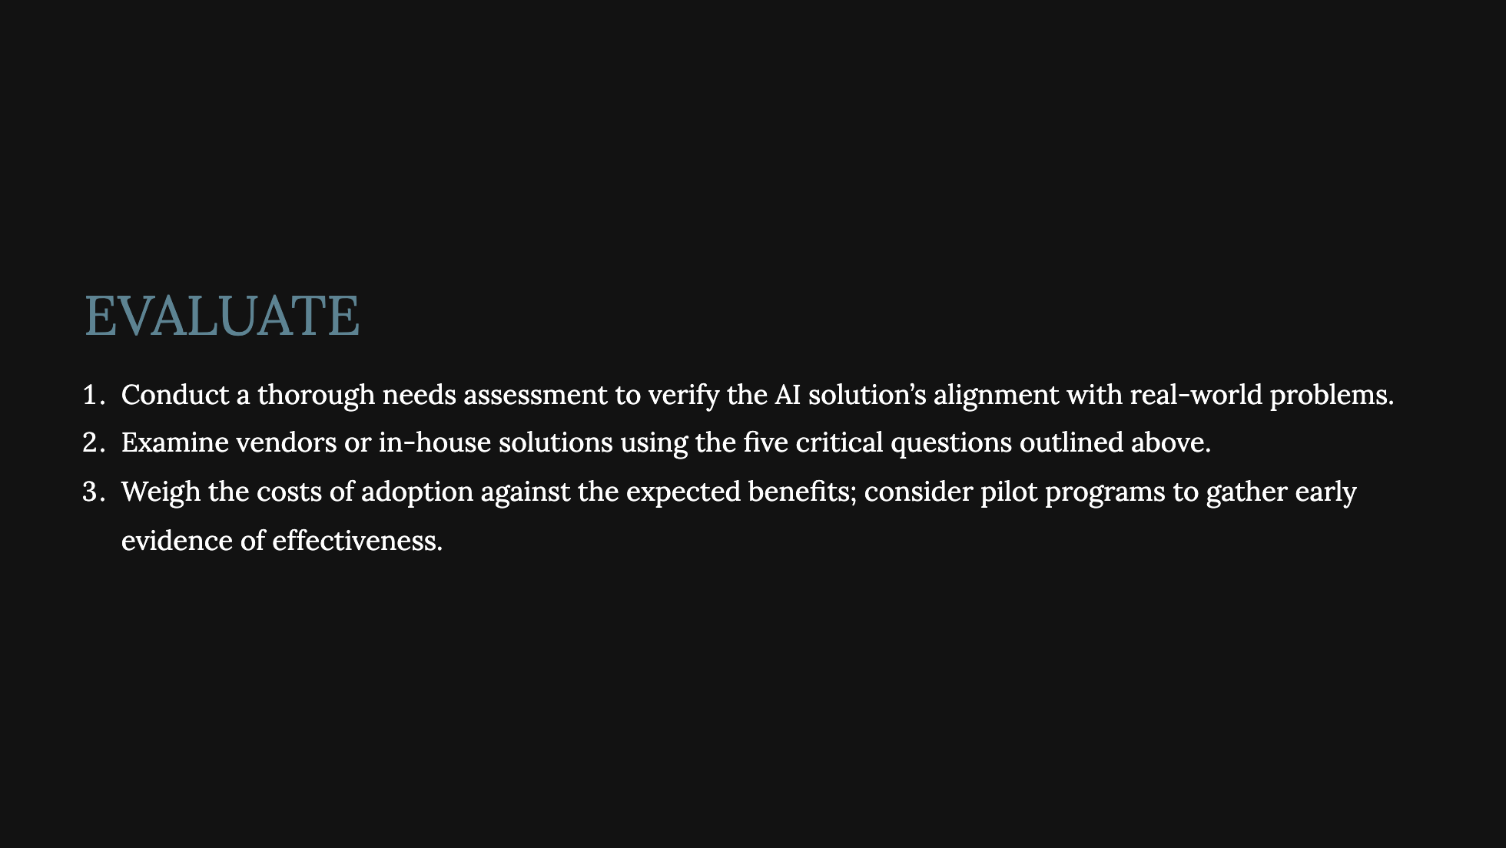

Slide 19
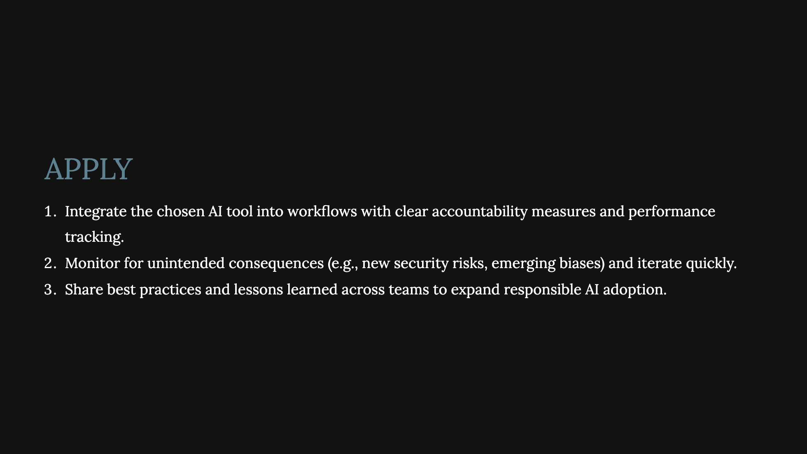

Slide 20
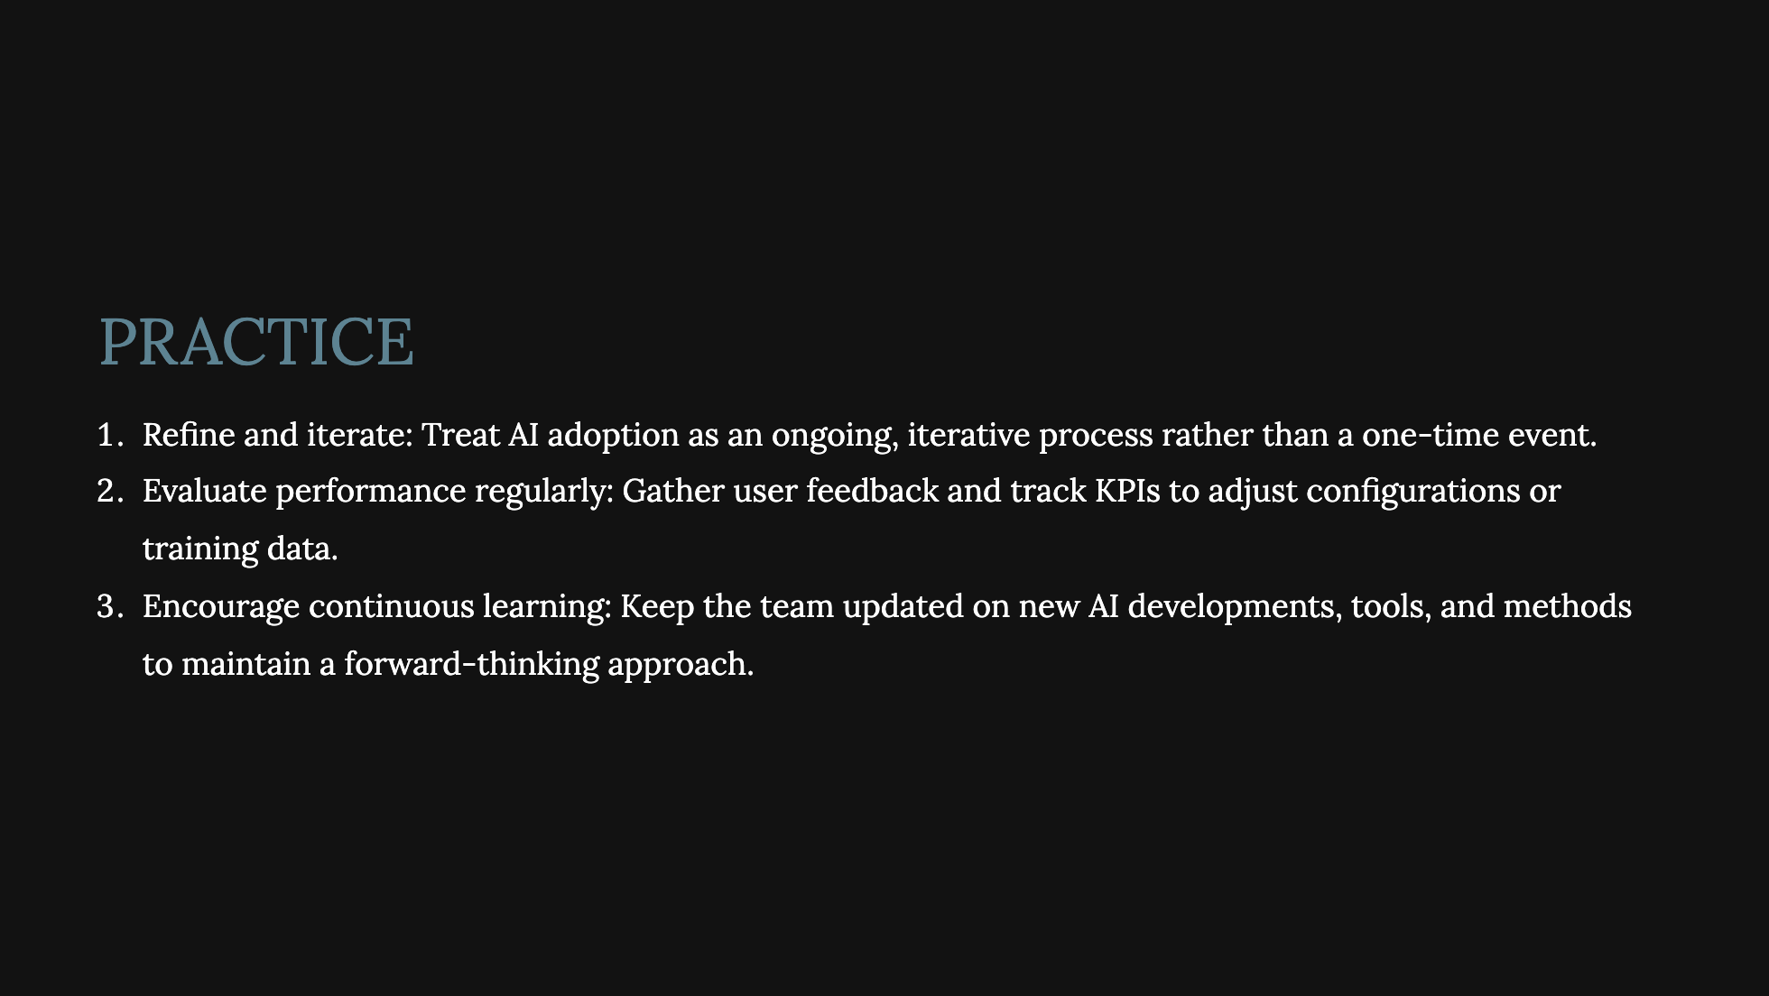

Slide 21
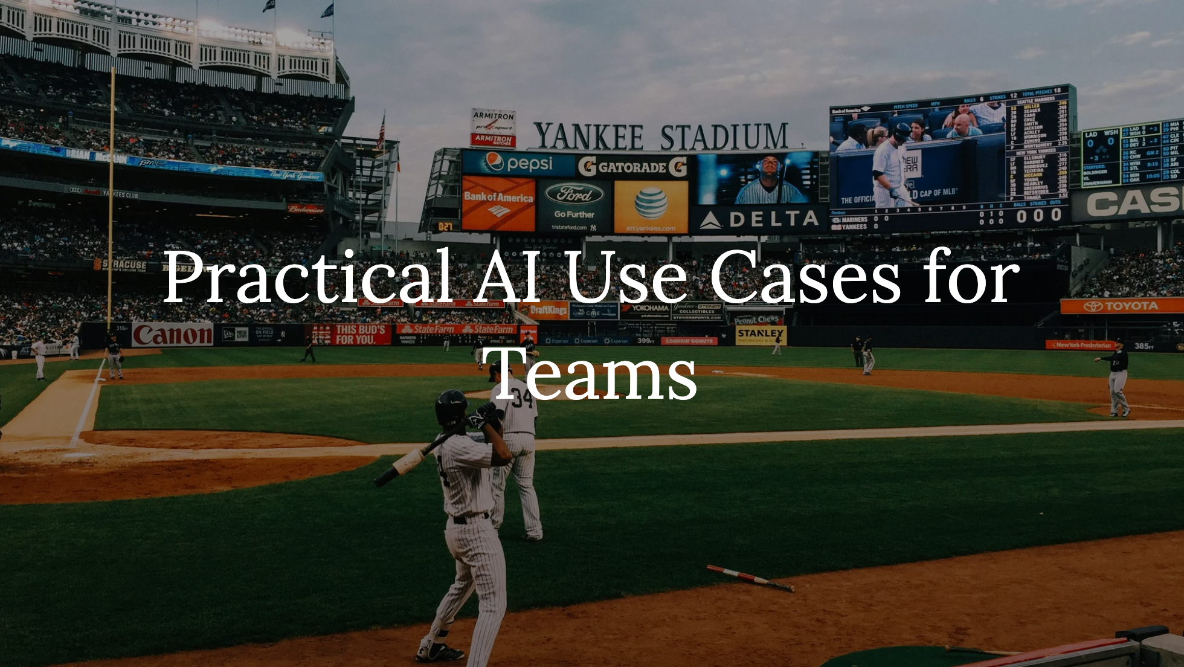
Notes:
- **Product Managers**: Research, decision-making, roadmap planning - **Designers**: User research, automation, accessibility improvements - **Developers**: AI pair programming, debugging, automation - How cross-functional teams can work together to **leverage AI without breaking workflows**

Slide 22
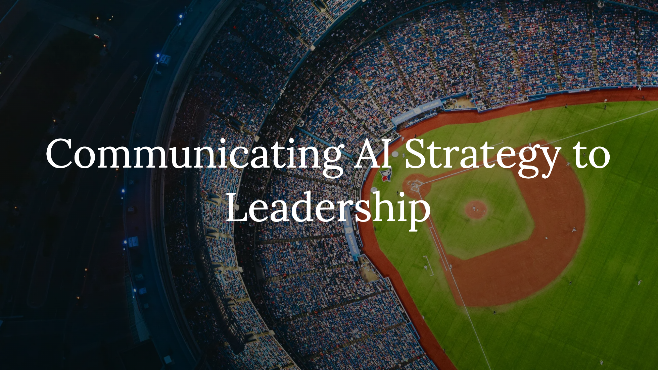
Notes:
- How to push back against **"We need AI because everyone else is using it!"** - Framing AI as a tool, not a trend: Speaking the language of leadership - Realistic expectations: AI as an **incremental improvement**, not a revolution overnight

Slide 23
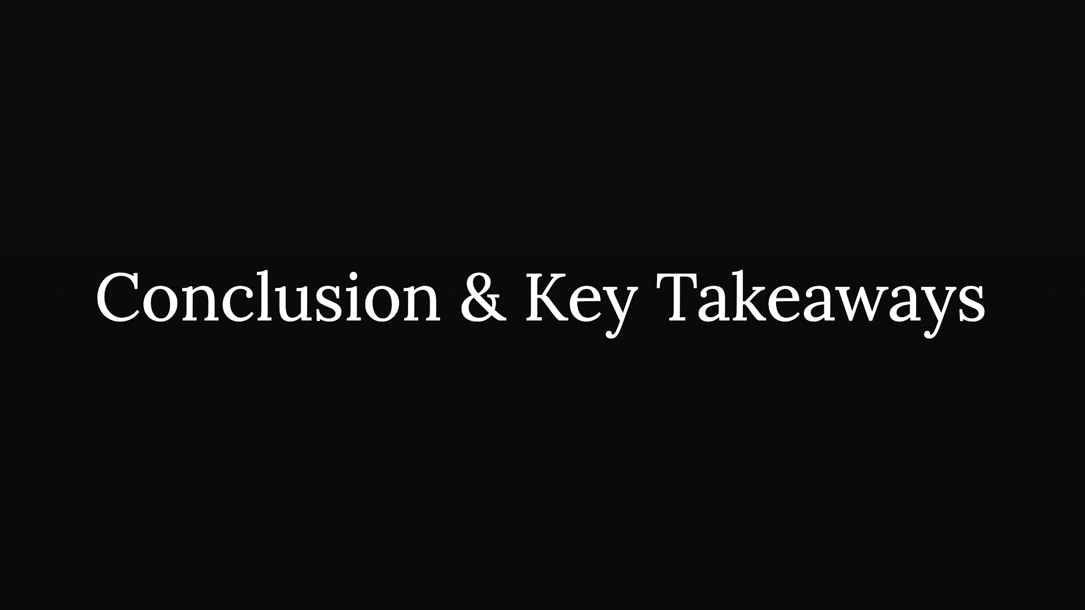
Notes:
- AI is a tool—**how you use it determines its value** - Smart adoption beats blind FOMO **every time** - **Final rubric reminder: - Ask the questions! - ** Learn, evaluate, apply **(in that order!)** - Q&A

